Slide 1
Evaluate expression tree
Binary Tree (23/07/10)

Slide 2
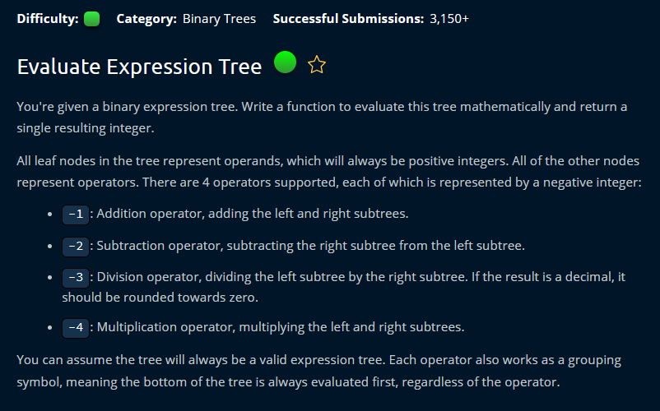

Slide 3
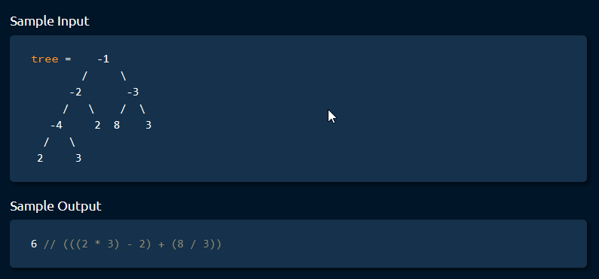

Slide 4


Slide 5


Slide 6


Slide 7
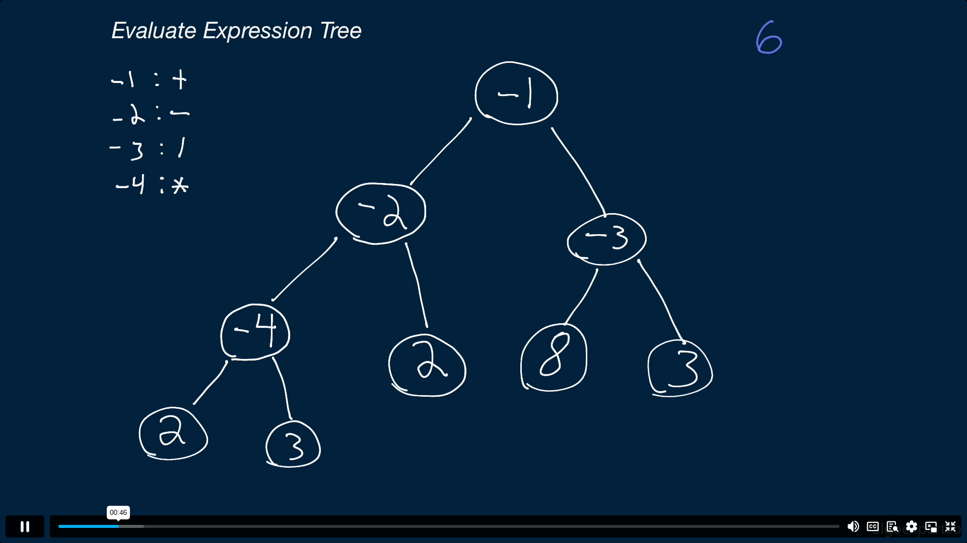

Slide 8
